Slide 1
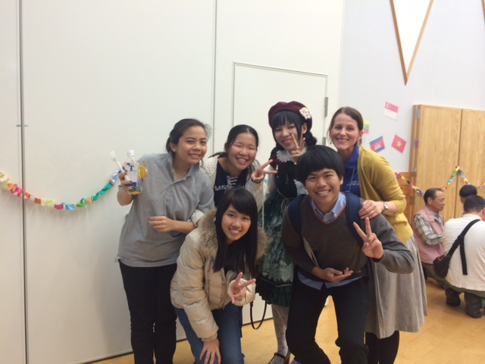
学校法人永原学園 西九州大学 と 佐賀県青年国際交流機構 presents 第１回 Discuss-ENG
Let’s get together and discuss two topics related to Japan and the world. Try speaking in English, meet foreigners living in Saga and meet other high school/university students interested in communicating in English.
Topic 1 is SCHOOL LIFE. Topic 2 is JAPANESE FOOD IS THE BEST IN THE WORLD!
Also, let’s make a Valentine’s Day craft item and enjoy afternoon tea!!
申し込み Contact: Nicole Sonobe
西九州大学 講師
090-1162-3663
sonobeni@nisikyu-u.ac.jp
締め切り２０１５年２月１０日(火）
DAY/DATE | February 15, 2015 (Sunday)
TIME | 13:00 -16:00
PLACE | 西九州大学 神埼キャンパス ３号館４階 ＡＬＳ
COST | Free Registration necessary
BRING | dictionary, pencil case, scissors
WHO | High school students Foreigners living in Saga University students (Approx. 30-40 students. First come basis)
FREE School Bus ご利用可能！
神埼駅北口発 12:35
大学発 16:20

